Slide 1
Subcommittee on Minnesota Water Policy
March 9, 2020
Co-Chairs: Sen. Bill Weber
Rep. Peter Fischer
Jim Stark, Director

Slide 2
Agenda
Call to Order
Approval of Minutes, February 17, 2020
Director’s Report – Subcommittee Priorities: Jim Stark
Changing Groundwater Conditions in the Metro: Ray Wuolo, Barr
Discussion - Wadena County Petition Response
Discussion: Irrigation Permits and Property Transfers: Jason Moeckel, DNR
Watershed Districts ~ Enabling Statutes and Governance: Emily Javens, Association of Watershed Districts
SWCD Funding Options: LeAnn Buck, Association of SWCDs
Announcements and Schedules
  Adjourn

Slide 3
Presentation
Director’s Report: Subcommittee Legislative Priorities ~ Jim Stark

Slide 4
Director’s Report:
Proposed Legislative Water Policy Topics for 2020
Legislative topics – based on member suggestions, input from constituents, agencies, and stakeholders
Bills have been prepared
Progress: Introductions and hearings

Slide 5
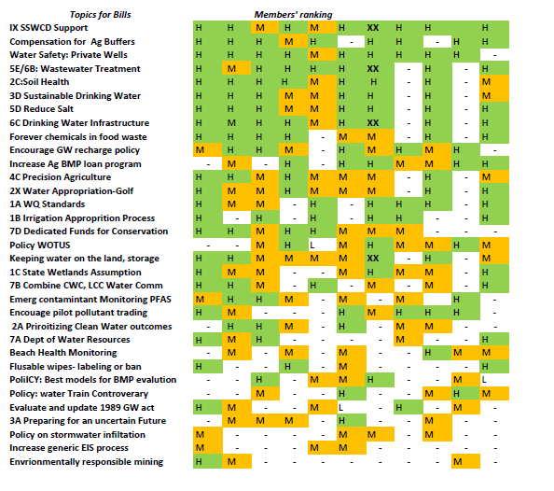
Issues: Topical Support

Slide 6
Presentation 2:
Changing Groundwater Conditions in the Metro: Ray Wuolo, Barr Engineering

Slide 7
Discussion:
Wadena County Petition Response – Jim Stark

Slide 8
Presentation 3:
Irrigation Permits & Property Transfers: Jason Moeckel, DNR

Slide 9
Presentation 4:
Watershed Districts – Enabling Legislation & Governance: Emily Javens, Association of Watershed Districts

Slide 10
Presentation 5:
Soil and Water Conservation Districts Funding: LeAnn Buck, Association of Soil and Water Conservation Districts

Slide 11
Announcements:
Updates
Next meeting?
Thanks!

